Slide 1
Explanation of Diffusion Waves
Power Point # 2
By Michelle Goodman

Slide 2
Summary
Questions:
What is the relationship between beta, the single wave profile and t_{lag} for zero diffusion?
Can we extrapolate this relationship into the region below the bifurcation point? Thus predicting the diffusion case
What is the shape of the Global Wave profile determined by?
Can you determine $β$ from the concentration profile?

Slide 3
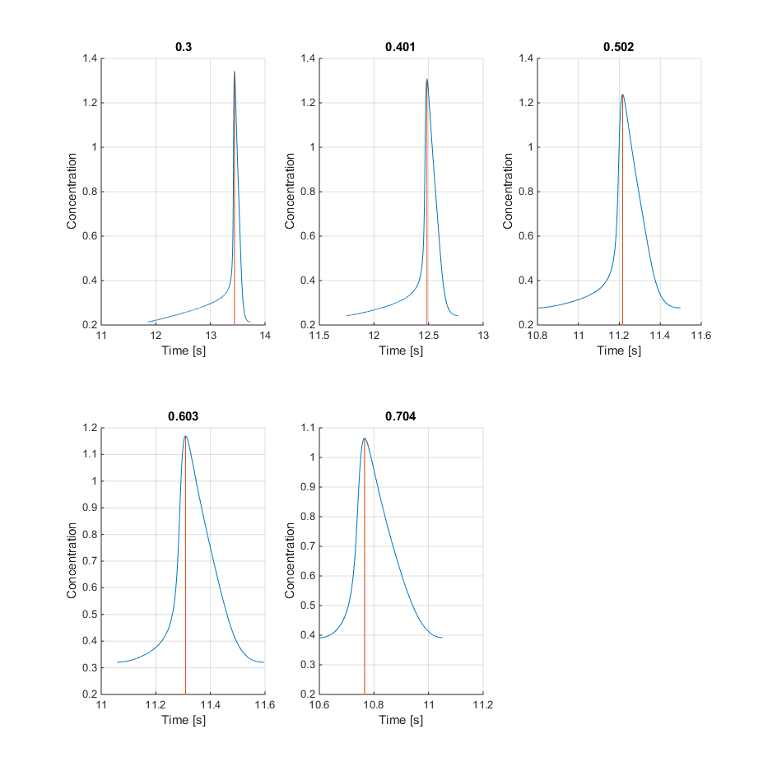
Beta vs Single Wave Profile
What is the relationship between beta, the single wave profile and t_{lag} for zero diffusion?

Slide 4
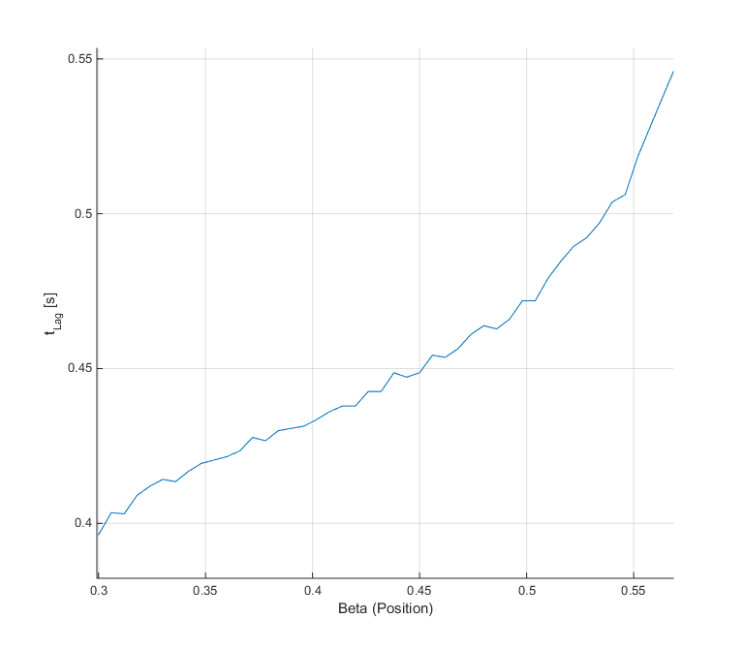
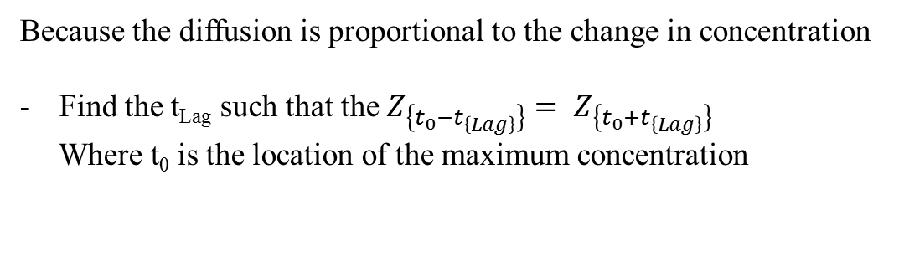
t_{Lag} vs Beta
What is the relationship between beta, the single wave profile and t_{lag} for zero diffusion?
Because the diffusion is proportional to the change in concentration
Find the t_{Lag} such that the $Z_{\left\{t_{0}−t_{\left\{Lag\right\}}\right\}}{= Z}_{\left\{t_{0}+t_{\left\{Lag\right\}}\right\}}$
Where t₀ is the location of the maximum concentration

Slide 5
Summary
Questions:
What is the relationship between beta, the single wave profile and t_{lag} for zero diffusion?
Can we extrapolate this relationship into the region below the bifurcation point? Thus predicting the diffusion case
What is the shape of the Global Wave profile determined by?
Can you determine $β$ from the concentration profile

Slide 6
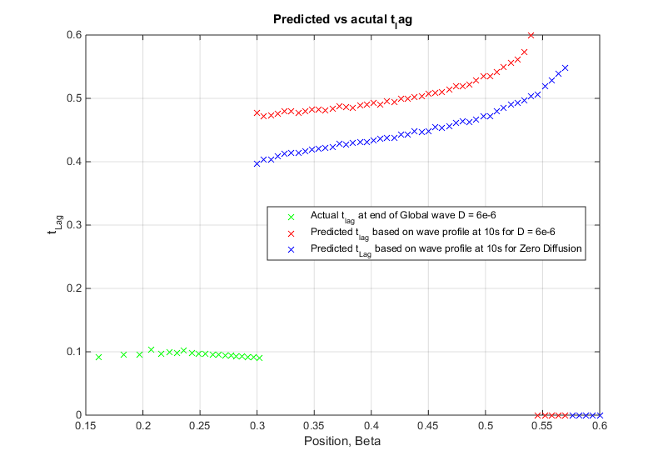
t_{Lag} vs Beta
Can we extrapolate this relationship into the region below the bifurcation point? Thus predicting the diffusion case
NO ☹
How much does the diffusion alter the height of the single wave profile
Does the single wave profile change with not only Beta but with Global wave number
Why not?

Slide 7
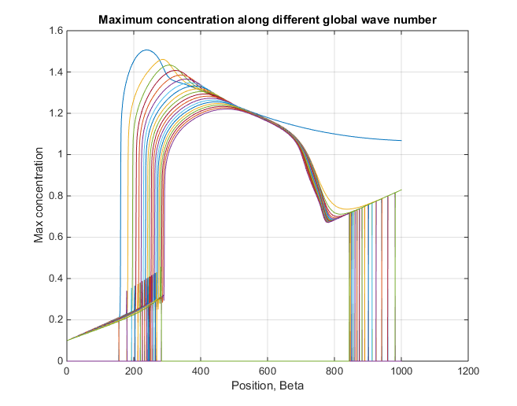

Slide 8
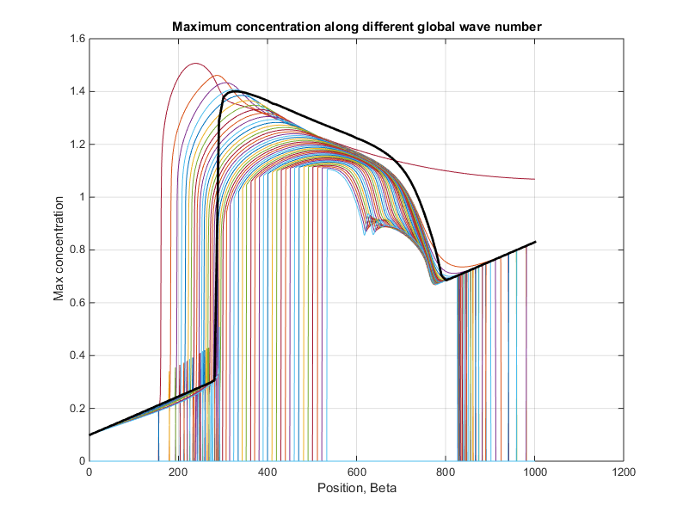
Wave number increasing
Zero Diffusion line

Slide 9
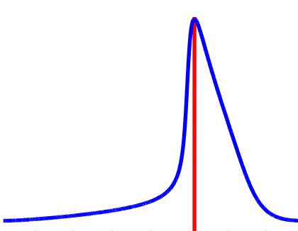
Beta vs Single Wave Profile
What is the relationship between beta, the single wave profile and t_{lag} for zero diffusion?
Maximum
Rate of Fast Increase
Rate of Decrease
Average Rate of Slow Increase
% Location
% Location
% Location

Slide 10
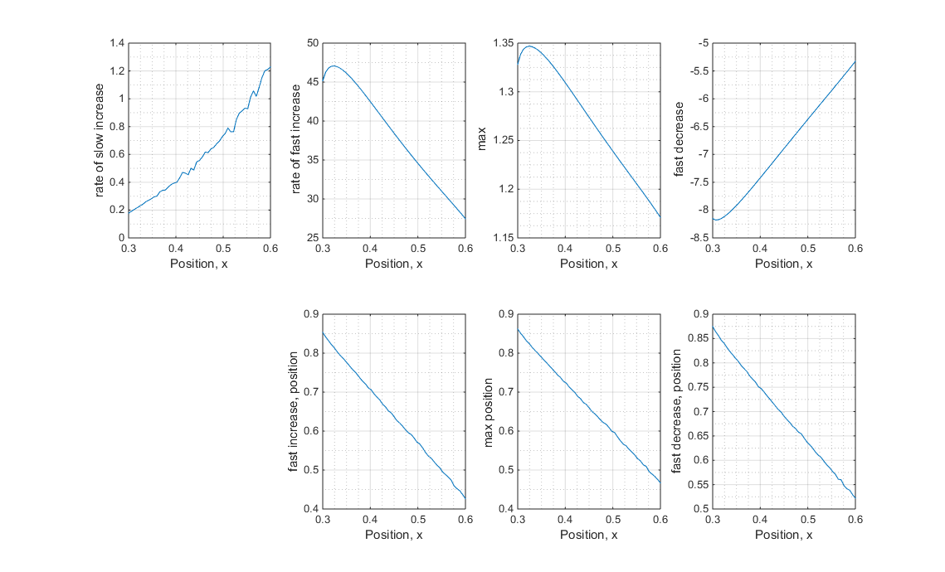
Beta vs Single Wave Profile
What is the relationship between beta, the single wave profile and t_{lag} for zero diffusion?

Slide 11
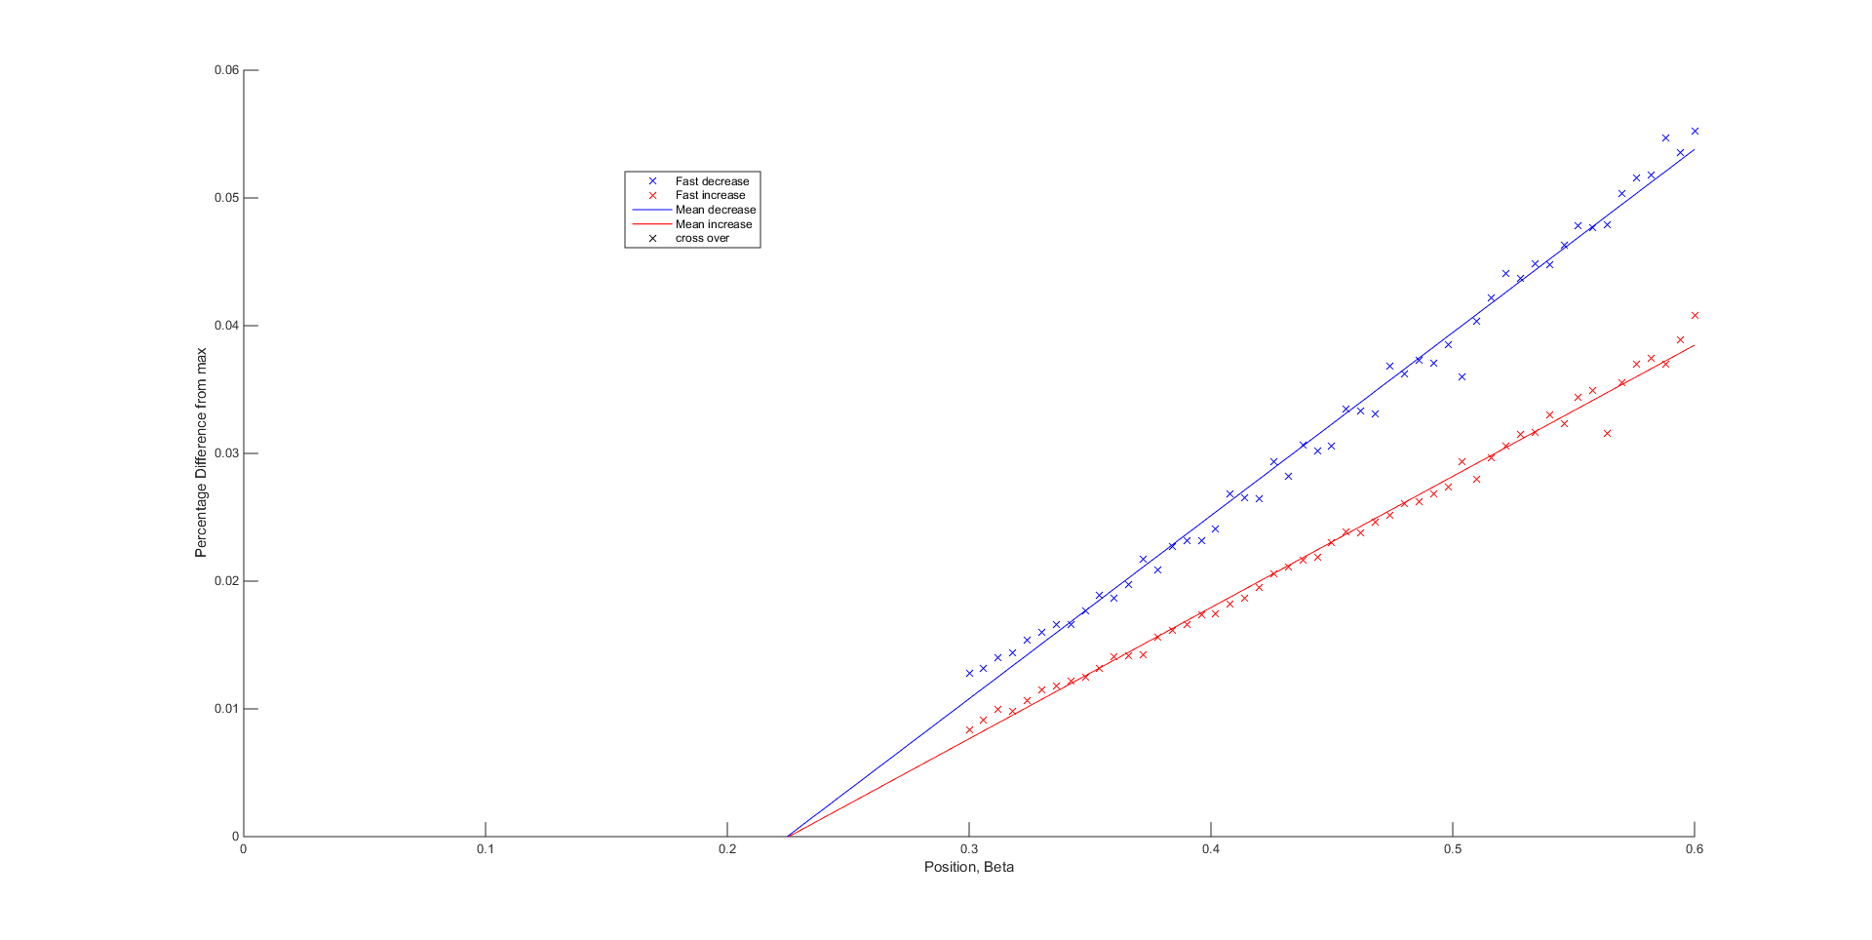
Beta vs Single Wave Profile
What is the relationship between beta, the single wave profile and t_{lag} for zero diffusion?
Is the wave profile tending towards symmetric?

